Slide 1

Miraculon-B
By Magdalena Choromanska

Slide 2
Is Miraculon-B effective?
In the group taking Miraculon-B, 207 out of 375 participants had a response, this is a proportion of 0.552.
In the group using the current standard of care, 123 out of 377 participants had a response, this is a proportion of 0.326.
To be more technical, there is strong evidence of a positive association between the drug and response (chi-squared test for no association, p < 0.0005).

Slide 3
The data suggests Miraculon-B is more effective than the standard of care.
The proportion of patients in the treatment group who had a response is 1.7 times higher than the proportion of patients in the control group who had a response, with 95% confidence interval for this relative risk being (1.4, 2.0).
The patients saw a substantial benefit.
The recommendation is to use Miraculon-B for patients.
The question to answer now is which subgroups of patients are benefiting more from the treatment?

Slide 4
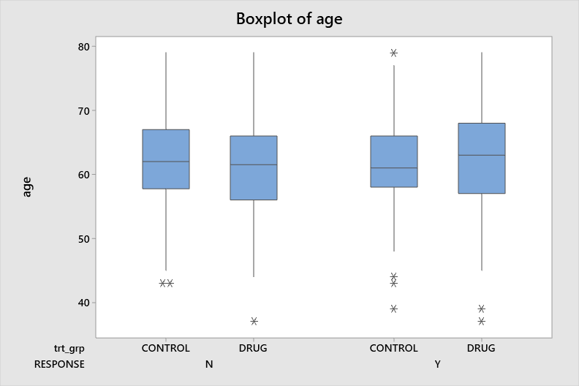
Exploring sub-groups of patients - age
The mean age among responders was 61.85,
62.09 in the treatment group
61.45 In the control group
The mean age among non-responders was 61.66,
61.16 in the treatment group
61.98 in the control group
The means are close to each other.
The distributions of ages in the different groups are similar.
There is no reason to believe that the age of a patient can predict whether they will respond to treatment.

Slide 5
Exploring sub-groups of patients – weight
The mean BMI among responder was 32.9,
32.1 in the treatment group
34.2 in the control group.
The mean BMI among non-responders was 31.9,
31.9 in the treatment group
31.9 in the control group.
The mean BMI is slightly higher for responders.

Slide 6
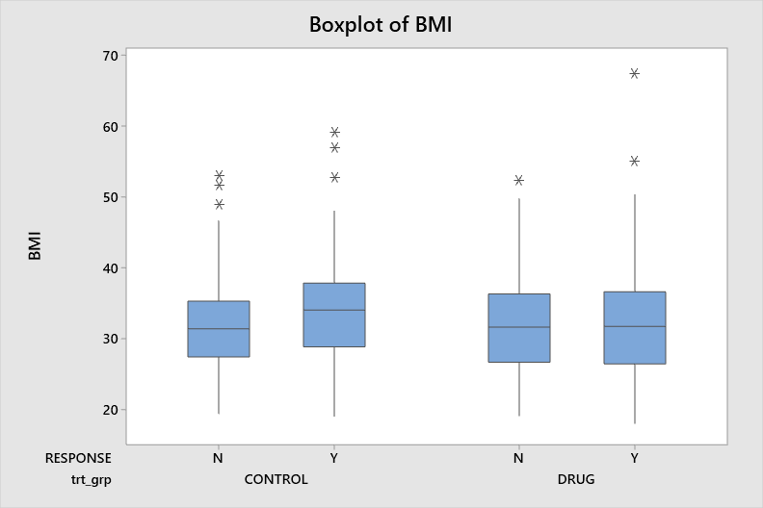
Exploring sub-groups of patients - weight
In the treatment group, the distributions of BMIs among responders and non-responders are virtually identical, except that there are a few high outliers positively skewing the mean for responders.
Therefore, the BMI of a patient cannot predict whether they will respond to treatment.

Slide 7
Exploring sub-groups of patients – protein concentration
A protein has been identified as a potential predictive biomarker of response for solid tumours.
The mean protein concentration among responders was 104.3,
103.7 in the treatment group
105.4 in the control group.
The mean protein concentration among non-responders was 135.7,
144.9 in the treatment group
129.6 in the control group.
The mean protein concentration is much higher for non-responders.

Slide 8
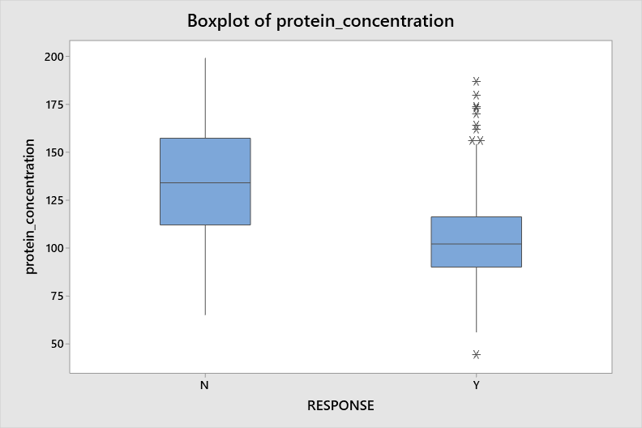
Exploring sub-groups of patients – protein concentration
There is strong evidence of a difference in protein concentration between responders and non-responders (t-test, p < 0.005).
An estimate of the mean difference in protein concentration between non-responders and responders is 31.4, with 95% confidence interval (27.6, 35.2).
Responders tend to have lower values of protein concentration.
Protein concentration can predict a response – a response is unlikely for high values of protein.

Slide 9
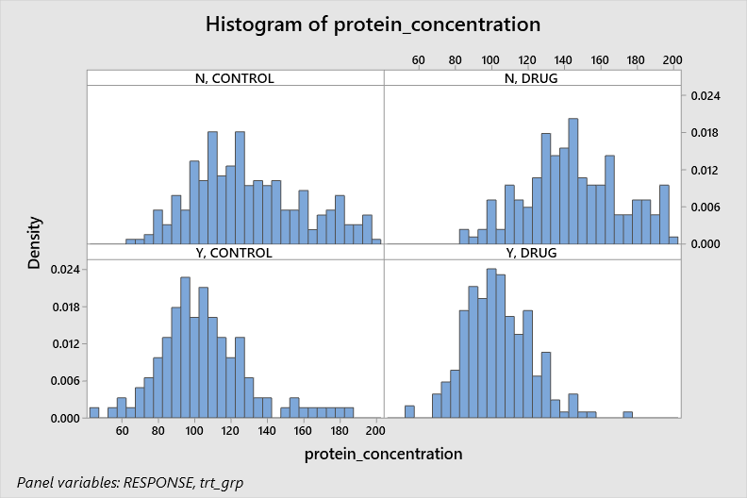
Exploring sub-groups of patients – protein concentration
Whether taking the drug or not, a response is unlikely for patients with protein concentration above 140. This effect appears to be even stronger in the treatment group – a response is extremely unlikely for patients with very high values of protein concentration. But for patients with lower levels of protein concentration the drug is effective: the mean among non-responders is higher in the treatment group than control, so the drug is more likely than placebo to have a response in patients with low levels of protein concentration.

Slide 10
Conclusions
Miraculon-B was found to be an effective treatment for patients with solid tumors.
The benefit does not seem dependant on the age of the patient.
The benefit does not seem dependant on the weight of the patient.
The benefit does seem dependant on the patient’s blood protein concentration – patients with blood protein higher than 140 do not benefit from the treatment.
The recommendation for prescribers is to prescribe Miraculon-B to patients of all ages and all weights, who have a blood protein concentration no higher than 140.

